Slide 1
1 Planed
Planed 1
Study task: week05 to quiz1 Due
Write a blog mainly about how to get the Teb and Peb.
4

Slide 2
1 Results
Results 1
Start the week06 study
Have not finished the analysis of the code in quiz1
Leave some problems about the conversion of png.
4

Slide 3
1 show
show
It is how I get the base address of GS(x64)/FS(x86).(the next slide)
I find that the `__readfsdword(0x18)` is actually the assemble code `mov eax,dword ptr fs:[18h]`
Note: the address of GS in memory is actually the base address of the PEB.
4

Slide 4
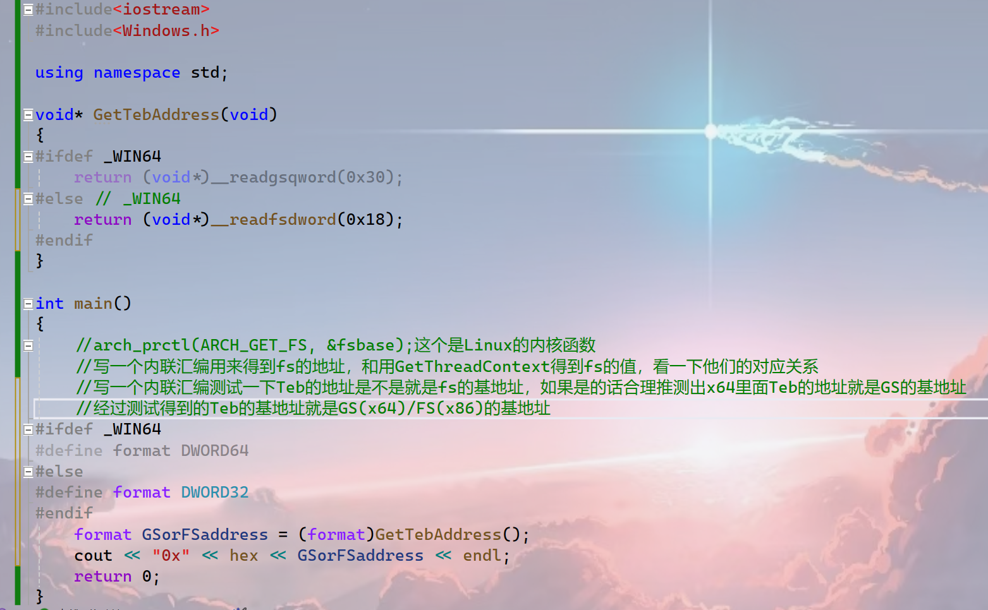
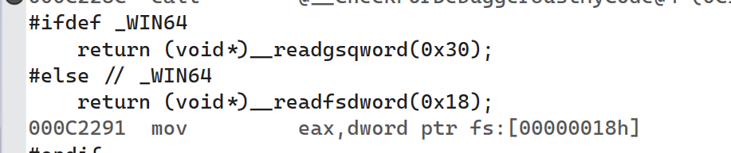
1 Challenges and Solutions
4

Slide 5
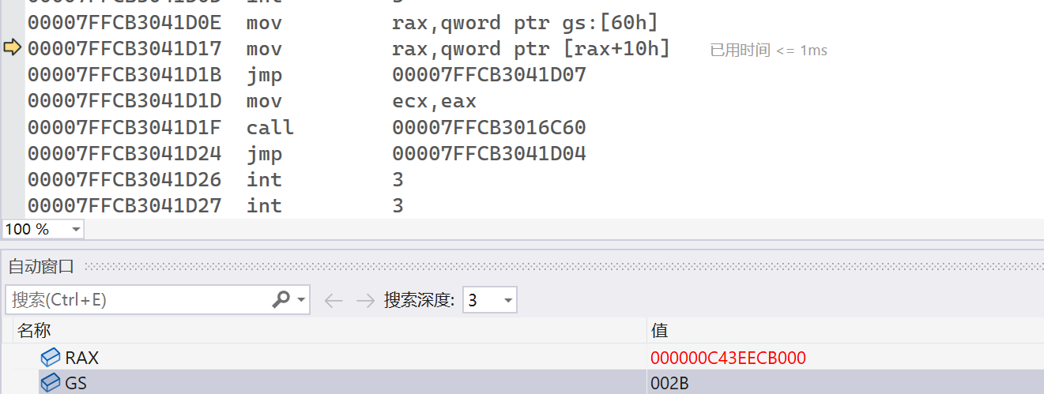
1 Challenges and Solutions
Challenges and solutions 1
I still don’t discover the relation between the value stored in GS and the base address of gs segment in memory. Mayby I do not need to focus on it?
The conversion , that between the value stored in GS corresponds to the base address of gs segment in memory, is done secretly by the operating system?
4

Slide 6
1 Challenges and Solutions
Challenges and solutions 1
My final goal is to convert the binary code(in `test.txt`) into a image(.png).
The `test.txt` stores the binary code of the `testPNG.png`.
For more details please look at my github:csci-591-fall2023-private/PNGConvertion/README.md at main · QXinHan/csci-591-fall2023-private (github.com)
Very sorry! There are some problems when I upload images to github. I will show you the details about how I get the image(.png) in the resource table and what the problem I have.
4

Slide 7
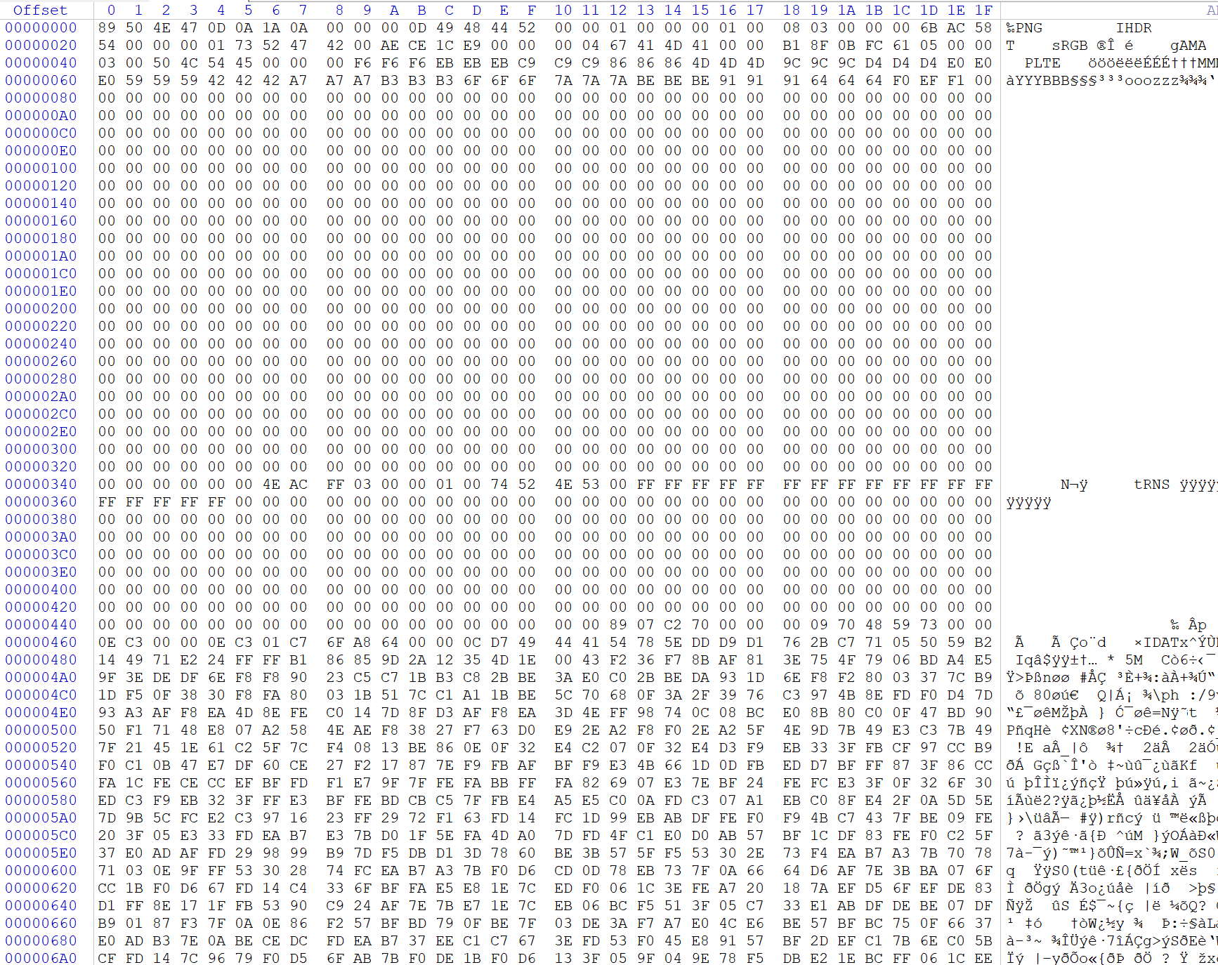
1 Challenges and Solutions
Challenges and solutions 1
4

Slide 8
1 Plan
plan 1
Finish the analysis of the code in quiz1 and quiz2.
Finish the study of week06.
Solve the problems in this week’s slides.
4

